Slide 1
A Regional Commercial Arbitration Council: Is it an idea whose time has come?
Ajay Thomas

Slide 2
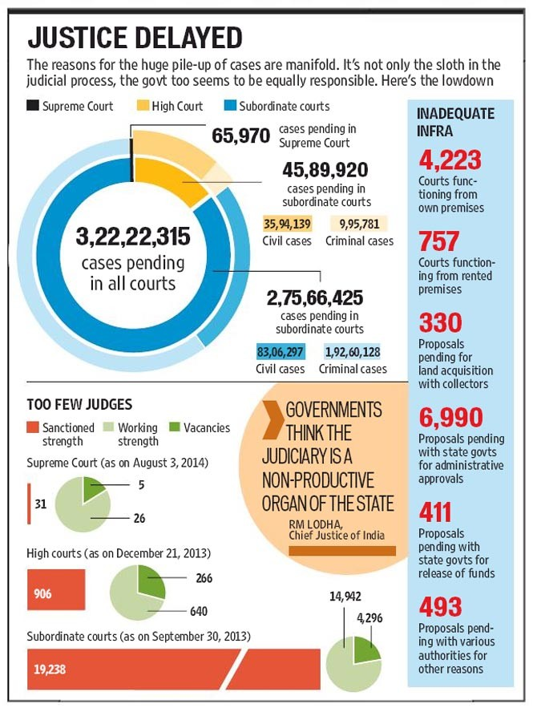
Why arbitration?

Slide 3
Why Arbitration?
“The future of arbitration is, therefore, bright, perhaps because the future of litigation is not ?”
Fali Nariman

Slide 4
Advantages
Privacy and Confidentiality of arbitration proceedings
Flexibility
Ability to choose the tribunal
Specialized expertise of Arbitrators
Finality. Generally no appeal
Neutrality & equality
Enforceability of the award
Case by case resolution of the dispute by the Arbitrators who are not necessarily tied to the law
Arbitration is typically less costly and faster than traditional litigation

Slide 5
Arbitration : The First Choice?
INDIA
74% of contracts had an arbitration clause
  Ernest & Young study Changing Face of Arbitration in India (2011)
91% of the companies surveyed included preferred arbitration (not litigation) for resolution of future disputes
  PriceWaterhouseCoopers ,Corporate Attitudes & Practices towards Arbitration in India 2013
INTERNATIONAL
88% of multinational corporations prefer international arbitration
86% of participating corporate counsel said that they were satisfied with international arbitration
  PriceWaterhouseCoopers - School of International Arbitration, Queen Mary, University of London study titled International Arbitration: Corporate Attitudes and Practices 2008

Slide 6
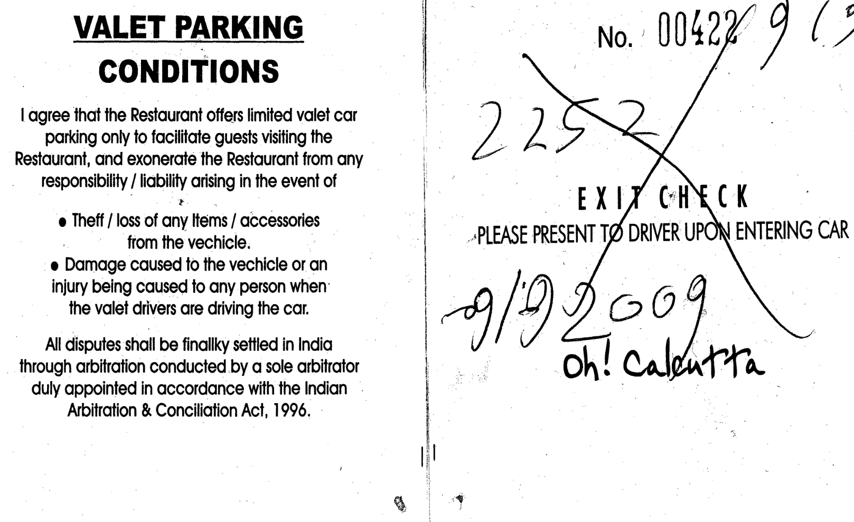

Slide 7
Arbitration in India: Reality Check
Anecdotal evidence seems to suggest that in excess of 90% of arbitrations in India are ad-hoc
“ the way in which the proceedings under the Act are conducted and without an exception challenged in courts has made lawyers laugh and legal philosophers weep........"
Guru Nanak Foundation v Rattan Singh & Sons (AIR 1981 SC 2975)

Slide 8
Arbitration in India: Reality Check
“ ….the cost of arbitration can be high if the arbitral tribunal consists of retirees…the government is forced to bear the high cost of arbitration by way of private arbitrator’s fee…The large number of sittings and charging of high fees per sitting, with several add-ons, without any ceiling, have many a time resulted in the cost of arbitration approaching or even exceeding the amount involved in the dispute…. …solution for this problem is to save arbitration from the arbitration cost…it is unfortunate that delays, high cost, frequent and sometimes unwarranted judicial interruptions at different stages are seriously hampering the growth of arbitrations as an effective dispute resolution process.
Union of India v Singh Builders Syndicate
(2009) 4 SCC 523

Slide 9
Institutional Arbitration – A plausible solution
Institutionalizing of arbitration in the SAARC region is the key instrument to make arbitration a success story
Disputes are submitted to arbitration with institutional oversight; usually conducted under the institution’s own comprehensive rules of procedure
The Rules provide the basic procedural framework
Value add in the arbitral process; important administrative and management functions of the arbitral proceedings provided for
Institution undertakes all logistical and administrative arrangements for the arbitration eg. booking of hearing rooms, secretarial services including transcription, interpretation and translation etc

Slide 10
Advantages
The rules of an institution provide the safety net
  injects greater predictability into the process
Supervision over the appointment of a Tribunal, ensuring impartiality and quality of the Tribunal
Avoids the discomfort of parties and arbitrators of having to negotiate/fix the fees of arbitrators
Professional, specialized staff to administer the arbitration
  reduces the risk of procedural breakdowns
  arbitrators and parties can seek the advice of the institutional staff on how to proceed in case of an impasse
Institutional oversight over the process
  reduces the risk of technical defects in the arbitration proceedings

Slide 11
Advantages
Managing costs and delays
Allows the arbitrators and parties to concentrate only on the adjudicative aspects of the dispute
Awards
  benefits of an institutional “label” on the award
  risk of a rogue award is greatly diminished
  possibility of challenge to an award is also reduced
  greater likelihood of voluntary compliance of the award

Slide 12
Claimant
Registrar
Article 1 Request for Arbitration
Date of receipt of Request and registration fee by Registrar deemed to be date of commencement of arbitration
Request for Arbitration served on Respondents
The Response
Formation of
Arbitral Tribunal
Article 4 - Response
Response within 30 days (including views on constitution of tribunal)
Article 5
Formation of Arbitral Tribunal (sole/three)
Article 8
Multi-party appointment of Arbitrator(s)
Article 13 All correspondence between parties and the arbitrators to be copied to Registrar
Parties file respective written statements and supporting documents
Tribunal may conduct further
Meetings and issue further directions (if necessary)
Award
Hearing
Article 26
Article 19
Article 15
GENERAL FLOW CHART OF ARBITRATION PROCEEDINGS UNDER THE LCIA INDIA RULES
Notes:
11

Slide 13
Parties’ greatest concerns in arbitration
The ultimate outcome – Win or lose?
Time - How long?
Costs - How much?

Slide 14
Time Management
The real value of institutional arbitration lies in the ability of the institution to push forward the case and deal with a party’s or arbitrator’s obstructiveness
Analysis of 100 recent LCIA cases, from Request for Arbitration to Final Award shows:
  around 52% concluded within twelve months or less
  around 78% concluded within eighteen months or less
Institutions take into account an arbitrator’s diligence or the lack of it in the final determination of the arbitrator’s fees.
Notes:
13

Slide 15
Choice of arbitrators
Before appointing an arbitrator, most arbitral institutions enquire from potential arbitrators on their caseload and availability (open hearing dates)
  LCIA India Rules – Article 5.3
    Before appointment, each arbitrator shall confirm his ability to devote sufficient time to ensure the expeditious conduct of the arbitration
  ICC - Article 11.2
    Statement of Acceptance, Availability, impartiality and independence
Amongst other criteria, emphasis by institutions on appointing arbitrators with a reputation for efficiency and control of proceedings

Slide 16
Need for Hearings?
Oral hearings not always necessary
Institutional rules provide for a documents-only arbitration
  LCIA India Rules - Article 19.1
  ICC Rules - Article 25.6
The present trend in international arbitration is towards fuller written submissions and shorter hearings
Unusual for a case to be decided solely on the basis of written submissions and documentary evidence
In a large majority of international cases, despite the considerable cost involved, parties still insist on a hearing

Slide 17
Use of Information Technology
Tele-conference
Video conference
Real-time transcription of hearings

Slide 18
Allocation of Costs
Allocation of costs is a very useful tool to
  Encourage efficient behaviour, and
  Discourage unreasonable behaviour
A key issue that may influence a tribunal’s decision on costs is the conduct of the parties/unreasonable behaviour during the course of the arbitration proceedings
Unreasonable behavior may include:
  Unwarranted claims and defences
  Dilatory tactics
  Excessive document requests
  Unreasonable objections to document requests
  Failure to comply with procedural orders
  Party’s failure to accept reasonable early settlement offers

Slide 19
Allocation of Costs
Cost awards can be used as a procedure to policing or sanctioning orderly conduct by parties in arbitrations
  For e.g. A party might be forced to rethink its decision to submit excessive document production requests, if advised by the tribunal that this could lead to the award of cost involved to the other side
Rules of most arbitral institutions contain specific provisions relating to the award of costs in arbitrations
  LCIA India Rules - Article 28
  ICC Rules - Article 37

Slide 20
Cost of Arbitration
Arbitrators fees
Arbitrators expenses
Expenses relating to witness and expert evidence
Administrative fees of institutions
  Registration Fee – generally not refundable
Lawyers fees
Cost of facilities & support services
  hearing rooms
  translators
  transcription

Slide 21
Cost of Arbitration
82% - cost borne by the parties to present their case
(lawyer’s fees and expenses, expenses relating to witness and expert evidence)
16% - Arbitrators’ fees and expenses
2% - Administrative expenses of the arbitral institution
  ICC Commission on Arbitration, Techniques for controlling time and costs in arbitration (ICC Publication No. 843)
Most of the costs of international arbitration are counsel’s costs
    PriceWaterhouseCoopers - School of International Arbitration, Queen Mary, University of London study titled International Arbitration: Corporate Attitudes and Practices 2006
Emphasis therefore must be on measures aimed at reducing costs associated with parties presenting their cases

Slide 22
Ad-hoc or Institutional Arbitration?
“ Ad-hoc arbitration is like a Rolls Royce of 1920’s vintage – stately, high fuel consumption (arbitrators fees are based on the number of ‘sittings’) and it takes almost an eternity for completion.
Institutional Arbitration could be likened to a Honda Accord, it will take you to the same destination with greater speed, higher efficiency and dramatically less fuel consumption. ”

Slide 23
The rise and rise of Institutional Arbitration
Notes:
From 1980 to 2007 the number of parties in ICC arbitration has risen from 2.5 percent to 11.8 percent. Out on the 190 parties from South East Asia in 2007, 42 parties were from India (22 percent).
Also between 1992 and 2007 58 ICC arbitrations took place in India.
Stamp duty is imposed on arbitral awards in may states and is effectively a condition on the enforceability of the award, There is some uncertainty about which stamp duty is payable and how and by whom it should be paid.

Slide 24
International Arbitral Institutions - Caseload
Institution | 2012 | 2013 | 2014
ICC (International Chamber of Commerce) | 759 | 767 | 791
DIS (German Institution of Arbitration) | 125 | 121 | 132
SCC (Stockholm Chamber of Commerce) | 177 | 203 | 183
VIAC (Vienna International Arbitration Center) | 70 | 56 | 56
SCAI (Swiss Chamber’s Arbitration Institution) | 92 | 68 | 105
LCIA (London Court of International Arbitration) | 277 | 301 | ~ 300
ICDR (International Centre for Dispute Resolution) | 996 | 1165 | 1052
SIAC (Singapore International Arbitration Centre) | 235 | 259 | 222
CIETAC (China International Economic and Trade Arbitration Commission) | 1060 | 1256 | 1610
HKIAC (Hong Kong International Arbitration Centre) | 456 | 463 | ~ 500
ICSID (International Centre for Settlement of Investment Disputes) | 50 | 40 | 38
In total | 4297 | 4699 | ~ 4989

Slide 25
Arbitral Institutions in India
Indian Council of Arbitration (ICA), New Delhi
International Centre for Alternative Dispute Resolution (ICADR), New Delhi
Delhi High Court Arbitration Centre (DAC), New Delhi
Nani Palkhivala Arbitration Centre (NPAC), Chennai
Indian Merchants Chamber, Court of Arbitration, Mumbai
FICCI Arbitration & Conciliation Tribunal (FACT), New Delhi
LCIA India

Slide 26
Specialist Arbitral Institutions in India
Construction Industry Arbitration Council (CIAC), New Delhi
  construction and infrastructure sector
SCOPE Forum of Conciliation and Arbitration (SFCA), New Delhi
  disputes between public sector enterprises and private sector entities
Permanent Machinery of Arbitrators (PMA), Department of Public Enterprise, New Delhi
  commercial disputes between Public Sector Enterprises inter se and Public Sector Enterprise (s) and government departments

Slide 27
Business Chambers that have arbitration mechanisms
Bengal Chamber of Commerce and Industry, Kolkata
  jute industry
East India Cotton Association Ltd, Kolkata
  cotton trade
Council of Arbitration, Indian Chamber of Commerce, Kolkata
Bombay Stock Exchange, Mumbai
Bombay Chamber of Commerce and Industry, Mumbai
South India Cotton Association (SICA), Coimbatore
  cotton trade

Slide 28
Court-annexed Institutions
Delhi International Arbitration Centre (DAC)
The Arbitration Centre - Karnataka
Chandigarh Arbitration Centre (CAC)
Madras High Court Arbitration Centre

Slide 29
International Arbitral Institutions in India
LCIA India
  launched in 2009 as the first independent subsidiary of the LCIA outside of London
  Currently administering disputes in-excess of USD 3 billion
Permanent Court of Arbitration (PCA)?
  The PCA has signed a host country agreement with the government of India
  The agreement envisages the setting up of a regional facility in New Delhi
Chartered Institute of Arbitrators (CIArb) – India branch
  Training and accreditation body for arbitrators
Singapore International Arbitration Centre (SIAC)
  Marketing/liaison office

Slide 30
Arbitral Institutions in Bangladesh
Bangladesh International Arbitration Centre (BIAC)
  Established up by a number of bodies including the International Chamber of Commerce, Bangladesh (ICCB) and the Metropolitan Chamber of Commerce & Industry (“MCCI”)
Bangladesh Council of Arbitration (BCA)
  Set up by The Federation of Bangladesh Chambers of Commerce and Industry (FBCCI)

Slide 31
Arbitral Institutions in Pakistan
Karachi International Arbitration Centre (KIAC)
  Not an institution but a facility to conduct arbitration hearings
  Established by the Pakistan National Committee of the International Chamber of Commerce (PNC-ICC)
National Centre for Dispute Resolution (NCDR)
  Formerly known as Karachi Centre for Dispute Resolution (KCDR)
  Established in February 2007 with the approval of the High Court of Sindh and financial assistance of International Finance Corporation (IFC)
  Pakistan’s first mediation centre

Slide 32
Arbitral Institutions in Afghanistan
Afghanistan Center for Commercial Dispute Resolution (ACDR)
  initiated by Afghanistan Chamber of Commerce and Industries (ACCI), and funded by Harakat – Afghanistan Investment Climate Facility Organization (AICFO)
  Established in June 2015

Slide 33
Arbitral Institutions in Sri Lanka
ICLP Arbitration Centre
  Established in 1996
  Part of the Institute for the Development of Commercial Law and Practice (ICLP)
  With the assistance of SWEDECORP (Swedish International Enterprise Development Corporation) and SILD (Swedish Institute for Legal Development)
Sri Lanka National Arbitration Centre (SLNAC)

Slide 34
Arbitral Institutions in Nepal
Nepal Council of Arbitration (NEPCA)
  founded in 1991
  Based in Kupondole

Slide 35
Arbitral Institutions in Bhutan
Chapter 2 (Articles 4 - 24) of the Alternative Dispute Resolution Act of Bhutan, 2013
  calls into existence the “Bhutan Alternative Dispute Resolution Centre”, as an independent and non-governmental body

Slide 36
Arbitral Institutions in Maldives
Chapter XI (Articles 75 - 81) of the Arbitration Act, 2013
  For the purposes of this Act and in order to execute its duties under this Act, an arbitration center titled “Maldives International Arbitration Center” shall come into existence with the commencement of this Act.
  All work leading up to the establishment of the Arbitration Center until the commencement of its operations shall be carried out by the Attorney General.

Slide 37

SAARC Regional Arbitration Council?

Slide 38

SAARC Arbitration Council

Slide 39
SAARC Arbitration Council
It is an inter-governmental body mandated to provide a legal framework/forum within the region for fair and efficient settlement of commercial, industrial, trade, banking, investment and such other disputes as may be presented to it by the parties.
VISION
To be the most sought Arbitration Forum in the region, by becoming a centre of excellence for Alternate Dispute Resolution.
MISSION
To provide fair, inexpensive, expeditious and high quality arbitral and conciliatory services to resolve trade, commercial, investment and disputes of similar nature in order to facilitate the expansion of business activities in the region.

Slide 40
Evolution
1985 - Dhaka: The South Asian States met and decided to establish South Asian Association for Regional Cooperation (SAARC)
2004 - Islamabad: The SAARC Council of Ministers decides to establish Conciliation and Arbitration mechanism for the region under the auspices of SAARC.
2005 - Dhaka: An agreement for establishment of SAARC Arbitration Council (SARCO) was signed
2010: Secretariat established in Islamabad
  Headed by a Director General - Thusantha Wijemanna (Sri Lanka) preceded by Syed Sultan Ahmed (Pakistan)
  Rules modelled on the UNCIRAL Arbitration Rules

Slide 41

Parties
  Anyone having business in any of the SAARC regional country
  Any dispute which is in the nature of trade, commerce or investment and is in the SAARC region ,or a citizen of any SAARC member country is party to such dispute
  Parties to an agreement having a general arbitration clause executed in a country outside the SAARC region may apply to SARCO for arbitration if both parties agree to hold it at SARCO

Slide 42
SAARC and the New York Convention
State | Entry into force
Afghanistan | 28/02/2005
Bangladesh | 04/08/1992
Bhutan | 24/12/2014
India | 11/10/1960
Nepal | 02/06/1998
Pakistan | 12/10/2005
Sri Lanka | 08/07/1962
Maldives

Slide 43
Percentage of intra-regional trade vis-à-vis trade by the region with the rest of the world
ASEAN - >20 %
NAFTA - >50 %
SAARC - <5 %
SAARC on track to establishing a South Asian Economic Union
  Envisages free trade area in both goods and services

